Slide 1

Bitcoin and Blockchain

Slide 2
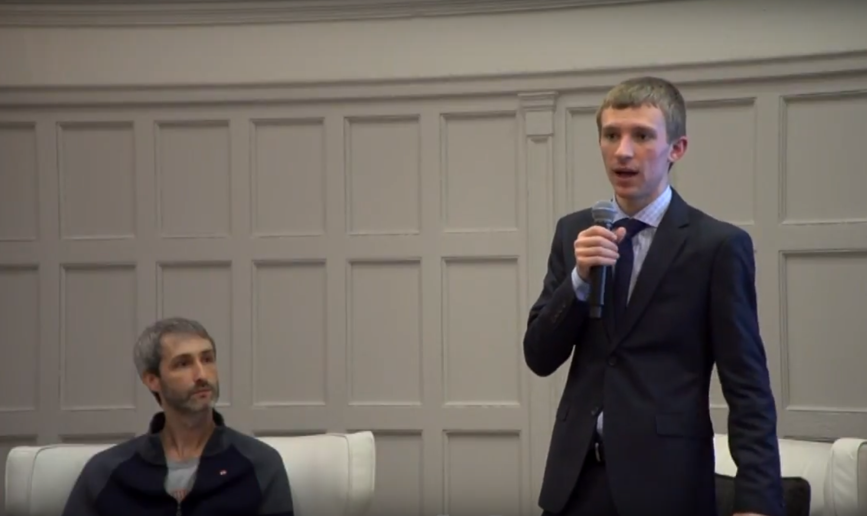



About Me

Slide 3
Disclaimer
None of this is investment or legal advice. It’s purely educational.

Slide 4
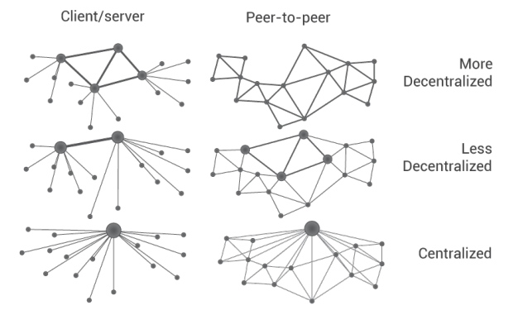
Centralization vs Decentralization

Slide 5

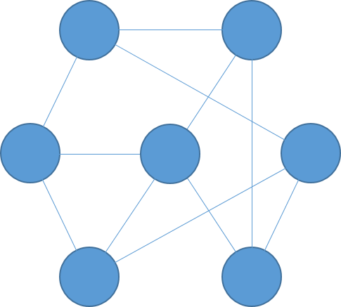
DECENTRALIZED
Older
Newer
BLOCK
Tx ID: wgis85cissajr5da7wz3fcnqnhift
Sender: w3fn5ujfm3d3r975qjd35jrwd4k5q
Receiver: nftic5k8sf4j598wf357jw38956659
Amount: 10 BTC
Notes:
In simple terms, Bitcoin is a decentralized network, where a history of the transactions is stored on thousands of computers around the world. This history is called the blockchain. The blockchain is a chain of blocks. Each block contains the most recent transaction history. There is a new block every 10 minutes. People will ask miners to include their transactions in the next block, often with a fee. The network automatically adjusts so that a new block can be added by one miner at random approximately every 10 minutes. Once a transaction is included in a block, it has a confirmation. People who are very cautious wait for several confirmations, since it is significantly harder to reverse an old transaction than a new one.

Slide 6
Bob
Alice
0.1 BTC
w3fn5ujfm3d3r975qjd35jrwd4k5q
nftic5k8sf4j598wf357jw38956659

Slide 7
Bob
Alice
0.1 BTC
w3fn5ujfm3d3r975qjd35jrwd4k5q
nftic5k8sf4j598wf357jw38956659

Slide 8


Slide 9

Mining (Proof of Work)
Tx ID: wgis85cissajr5da7wz3fcnqnhift
Tx ID: eh5vnc3c5bv ncxc3undm5x84q
Tx ID: cwab8nqf5ax7tcf45dxncnfmd3
Tx ID: t2C4hdsjz2xcn4renv5fadjxxje8e
Older
Newer
BLOCK

Slide 10
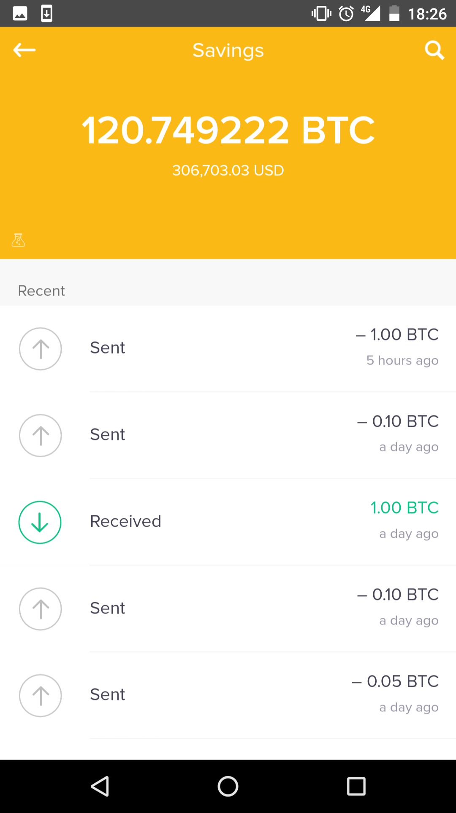
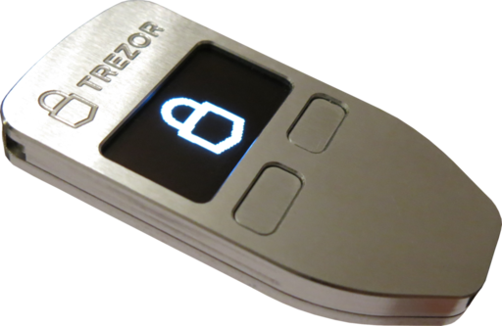

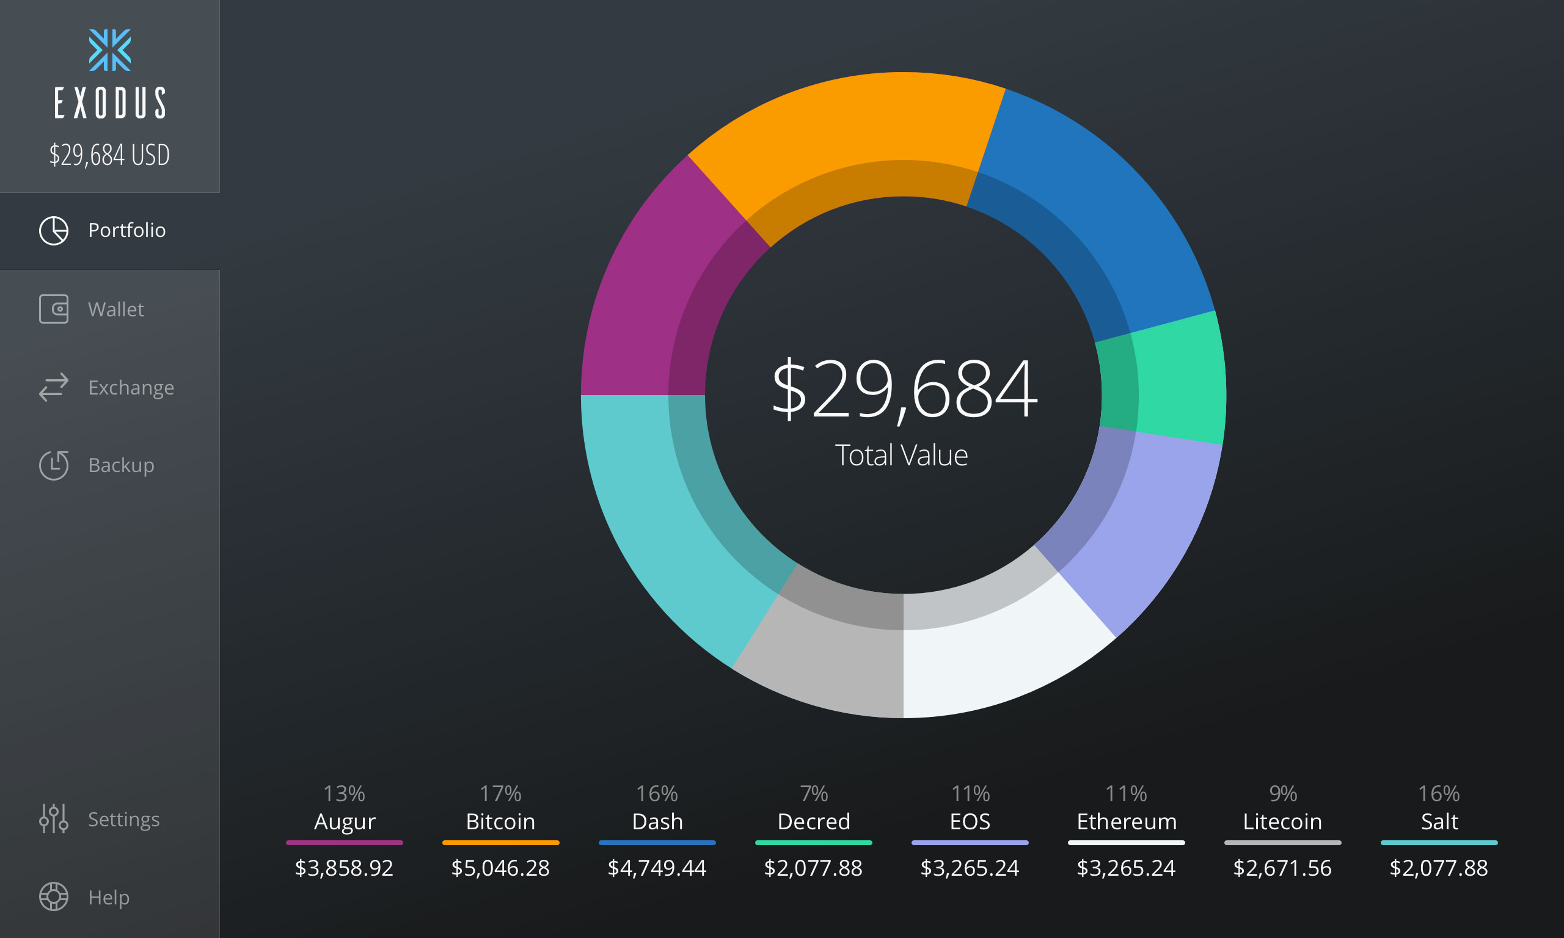
Wallets

Slide 11
Advantages of Cryptocurrencies
Security. When implemented correctly, blockchains offer strong security.
Trust. When implemented properly, blockchains allow people to interact without any addition of trust in individual parties.
Privacy. Not all cryptocurrencies provide privacy, but decentralized, trustless technology opens the door for strong, trustless privacy. Centralized systems typically can only provide trusted privacy.
Open-source. Most cryptocurrencies are open-source, meaning that other people can review the code, improve it, or make their own projects. It’s accessible to all across borders.

Slide 12
Disadvantages of Cryptocurrencies
Inefficiency. Blockchain technology (and typically decentralized networks in general) are less efficient than centralized counterparts.
Scalability. No current cryptocurrency is proven to scale to hundreds/thousands of transactions per second.
Consensus conflicts. Decentralized networks need to agree, which is very difficult. If there are disagreements, different forks may occur.
Transparency. Most cryptocurrencies are completely transparent. This could cause unintended side-effect, such as missing fungibility.

Slide 13


What’s Going on With Bitcoin?
Consensus conflicts. People disagreed on the solution to transaction backlogs. Bitcoin incorporated Segwit, Bitcoin Cash increased block size.
Few people use Segwit, though support is increasing.
Bitcoin transaction fees often exceed $5, occasionally $20.

Slide 14

What is Ethereum?
Both a financial layer and a coding layer
People can write code that is stored on the network and can be executed for a fee
Applications can be simple or complex
Can create tokens and other apps
Switching to Proof of Stake

Slide 15



Ethereum is Massively Inefficient

Slide 16
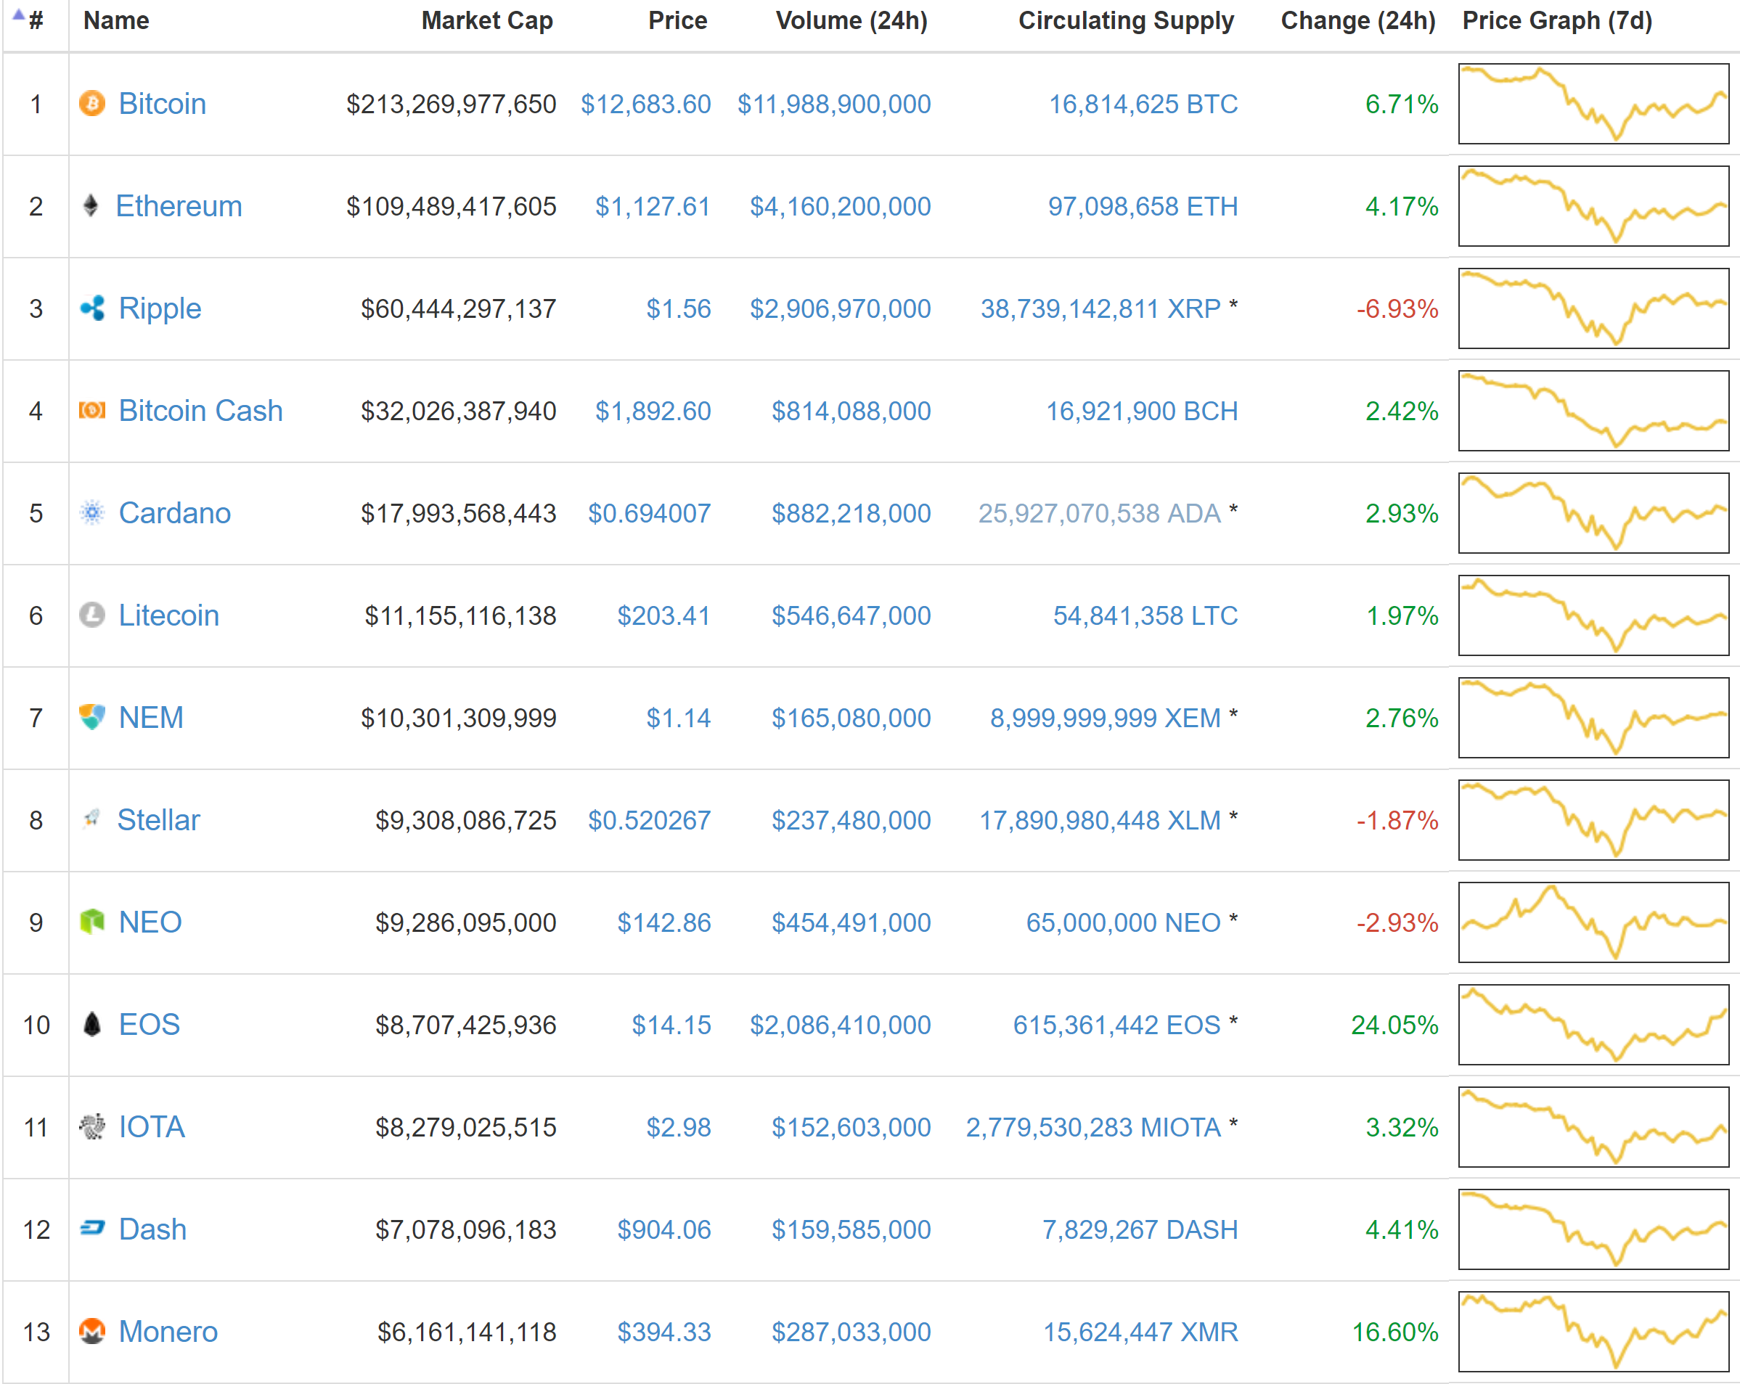
Many projects are valued highly even if they don’t have a working product!

Slide 17



What’s Next?
LIGHTNING NETWORK
PRIVACY
DAGs

Slide 18
Other Things to Remember
Projects can be started by anyone, and thus most are scams
When evaluating a project, ask if it needs to be decentralized
Start with the problem, not the solution
Support a decentralized project despite the team, not because of it
Ideology is just as important as technology
If you don’t control the private keys, you don’t control your money
Capital gains are taxed, so report it to the IRS
All these projects should be considered high-risk investments

Slide 19
What to Look For
A working product, NOT “the next big thing”
Strong, continuous development
A critical/skeptical community that can address hard questions
A problem that is more effectively addressed than by a normal company or centralized service
No premine, development tax/founder’s reward, or promised financial gain

Slide 20
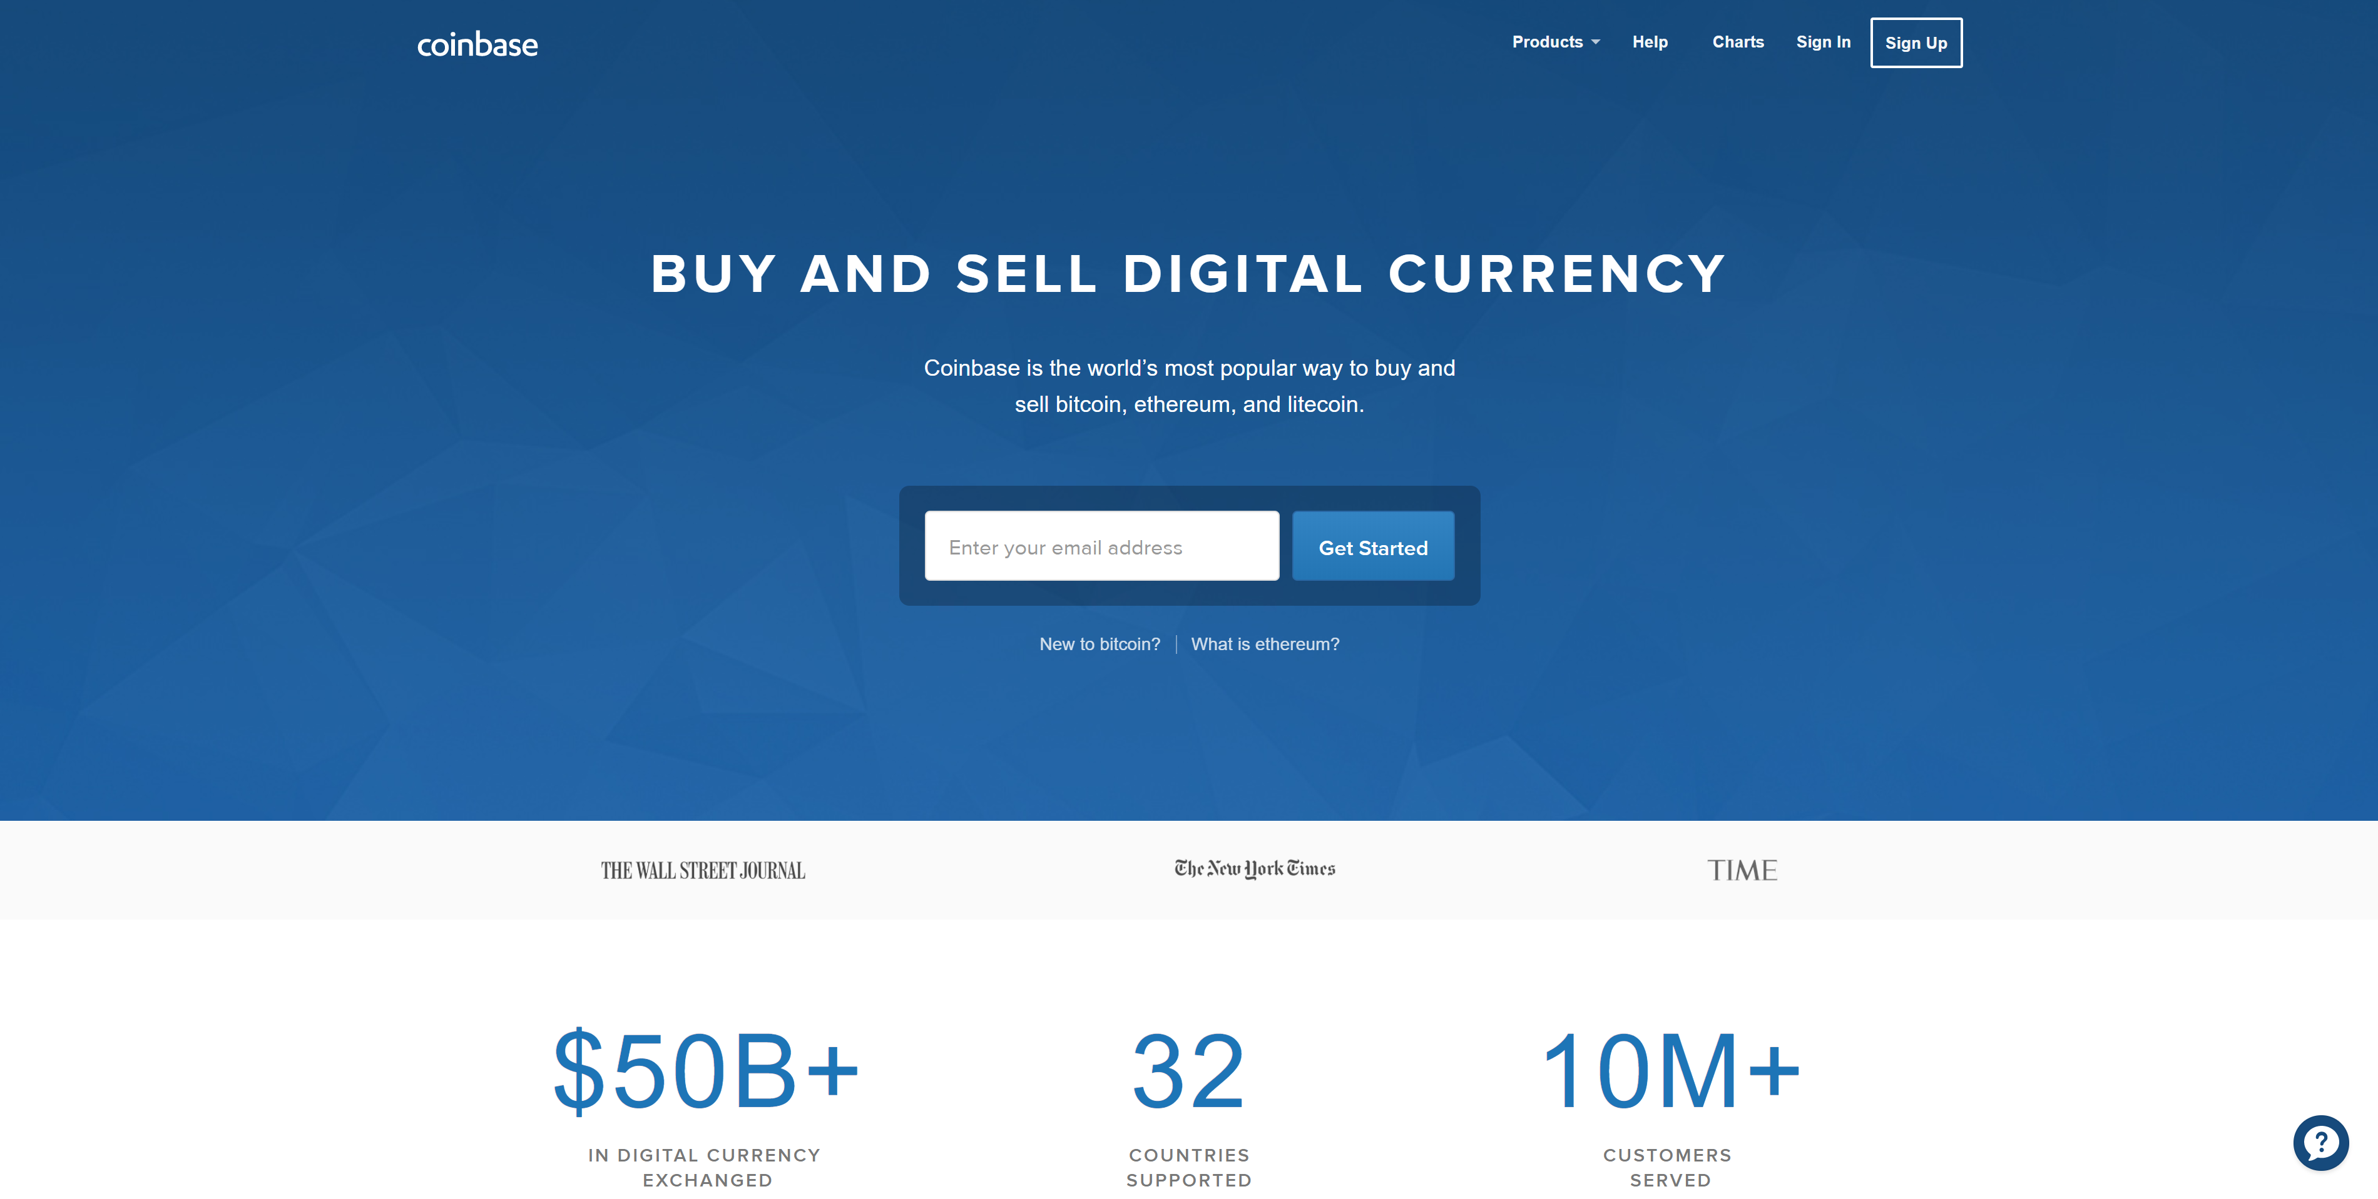
How to Get Started

Slide 21
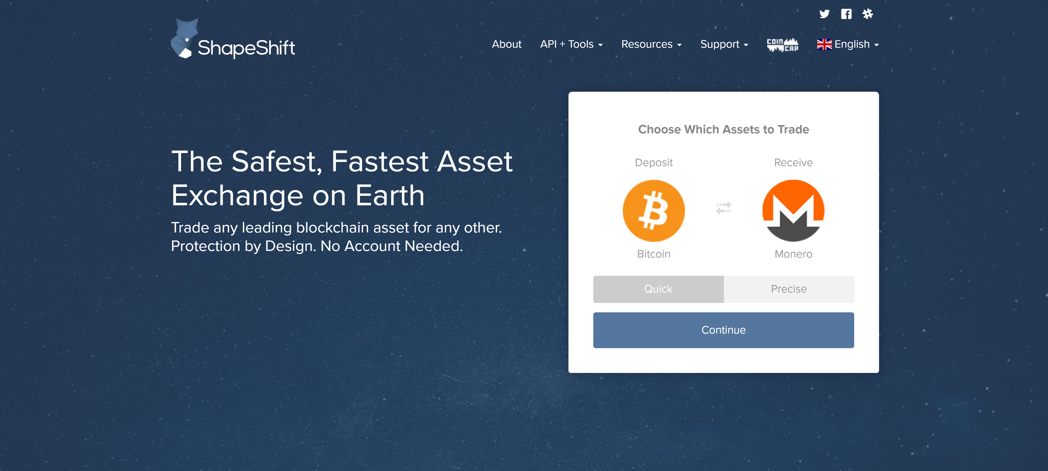
How to Get Started

Slide 22
Thank You!
justin@ehrenhofer.org

